Slide 1

Code for Action Spotting

Slide 2
Data Preprocessing
For each game loads predicted features,
For each game labels and store in the matrix (frames x classes), there are 17 classes. Then they are shifted (for their loss function)
For each game load bboxes and calibrations are loaded. Then for each frame they are used to project players localizations. The edges are defined between players who are not further to each other than the threshold value. The player features are colors, bbox area, center of the bbox and projected centre. The Dataset class from torch_geometric was used to store features and edges.
__getitem__: selects random events and gets corresponding clip features, clip labels, and players representation from the graph.
Possible improvement include more node features.

Slide 3
Model – Feature backbone
Applies both base convolutional layers and a temporal pyramidal module. (input=(clip x features))
There are two base convolutions. Then the output is forwarded to each of the pyramid convolutions and the outputs are stacked.
It aims capture and represent temporal information at multiple scales.

Slide 4
Model – Players backbone (GCN)
Depending on the the method (GCN, DynamicEdgeConvGCN, resGCN) the proper layers are initialized.
The graph representation is pushed through four GCNConv layers
Afterwards the global pooling method is applied and further operations to reshape the output properly.

Slide 5
Model – Segmentation module
Concatenate the outputs from the feature backbone and players backbone.
Utilizes convolutional layers on concatenated data to extract features.
Rearranges the output tensor's dimensions to prepare it for subsequent operations.
Applies normalization (sigmoid) to the reshaped tensor, scaling values with sigmoid function.
Computes segmentation scores representing the likelihood or presence of various objects or classes within the input image.

Slide 6
Model – Spotting module
Adjusts segmentation scores by inversing them to emphasize less confident predictions. Reshapes and permutes them to prepare them for further processing steps.
Concatenates the convolutional segmentation with reverted segmentation scores.
Employs convolutional layers, possibly after zero-padding, to extract intricate features.
Predicts both confidence levels and classes for potential detections or objects within the input.

Slide 7
Improvements
Apply more features to the graphs.
Apply different methods to capture temporal changes.

Slide 8
Segmentation Module - Analysis

Slide 9
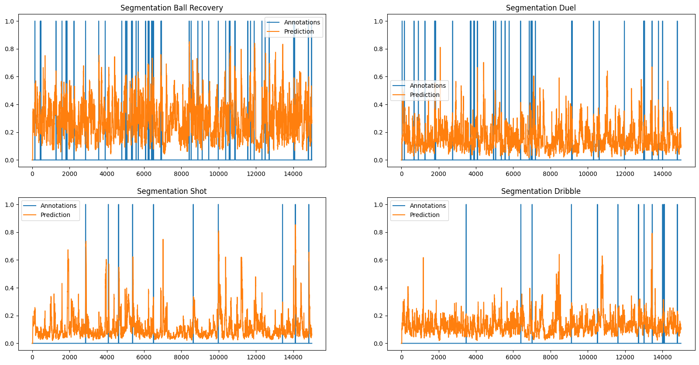
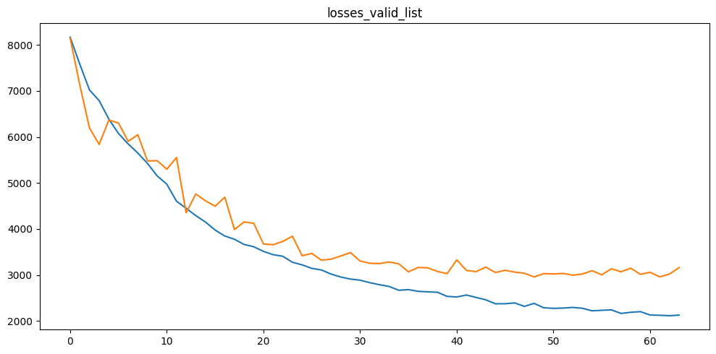
4-annotations

Slide 10
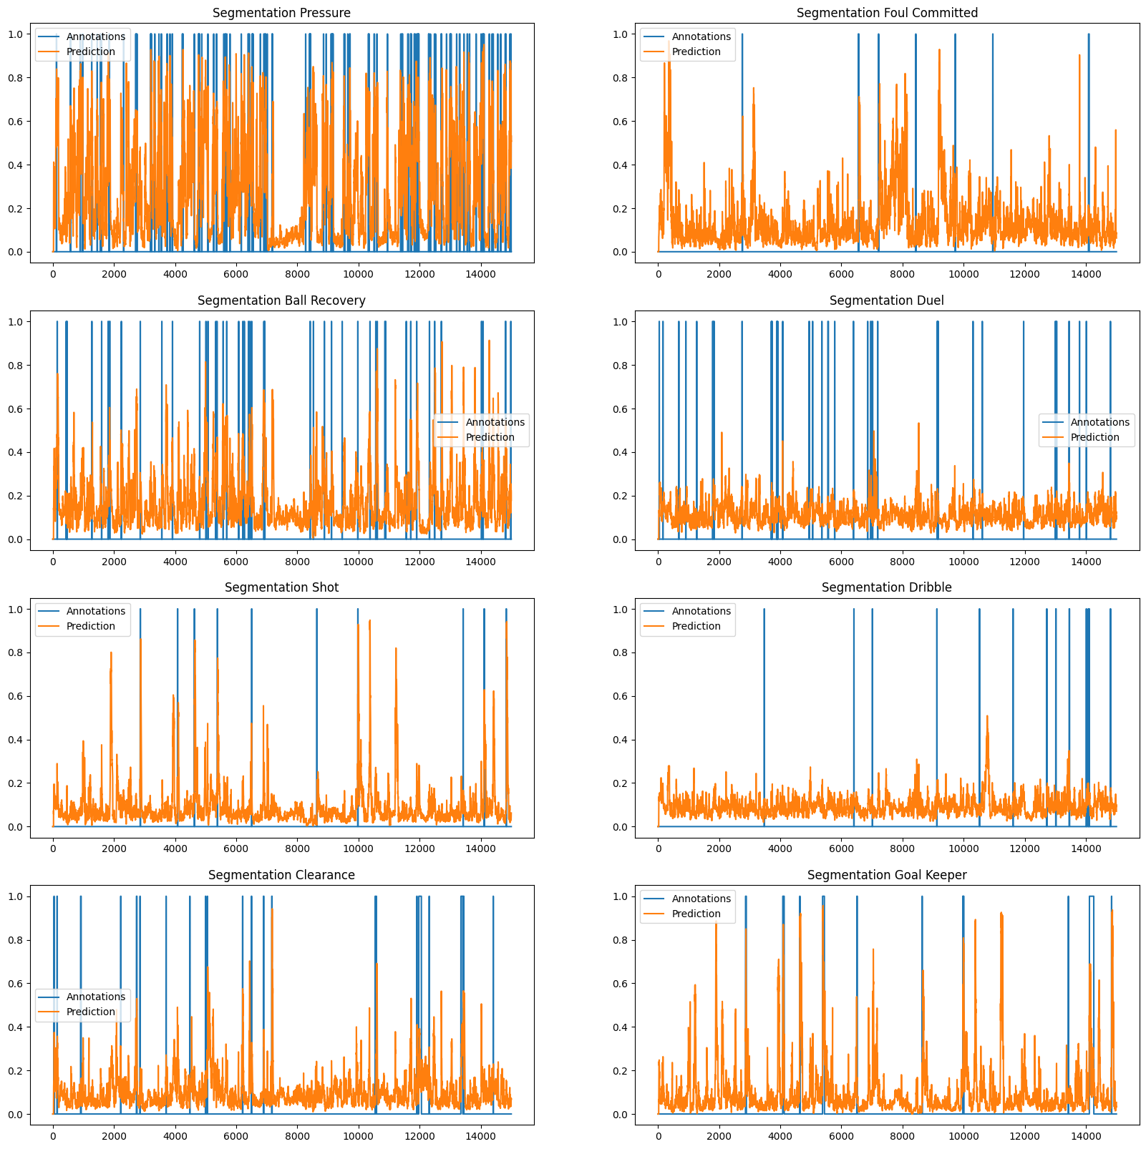
More Annotations chunk size - 60s

Slide 11
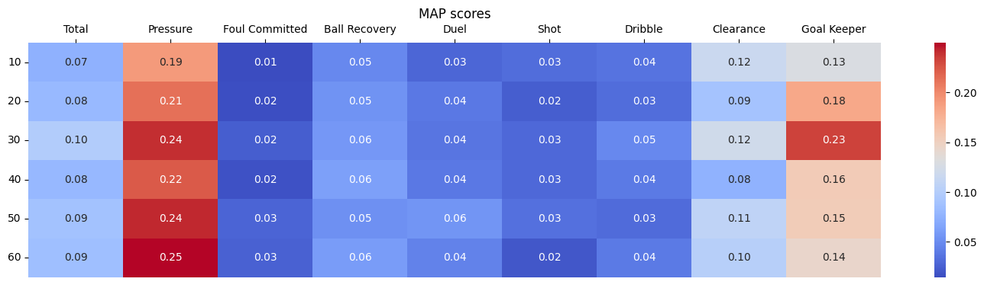
Grid Search

Slide 12
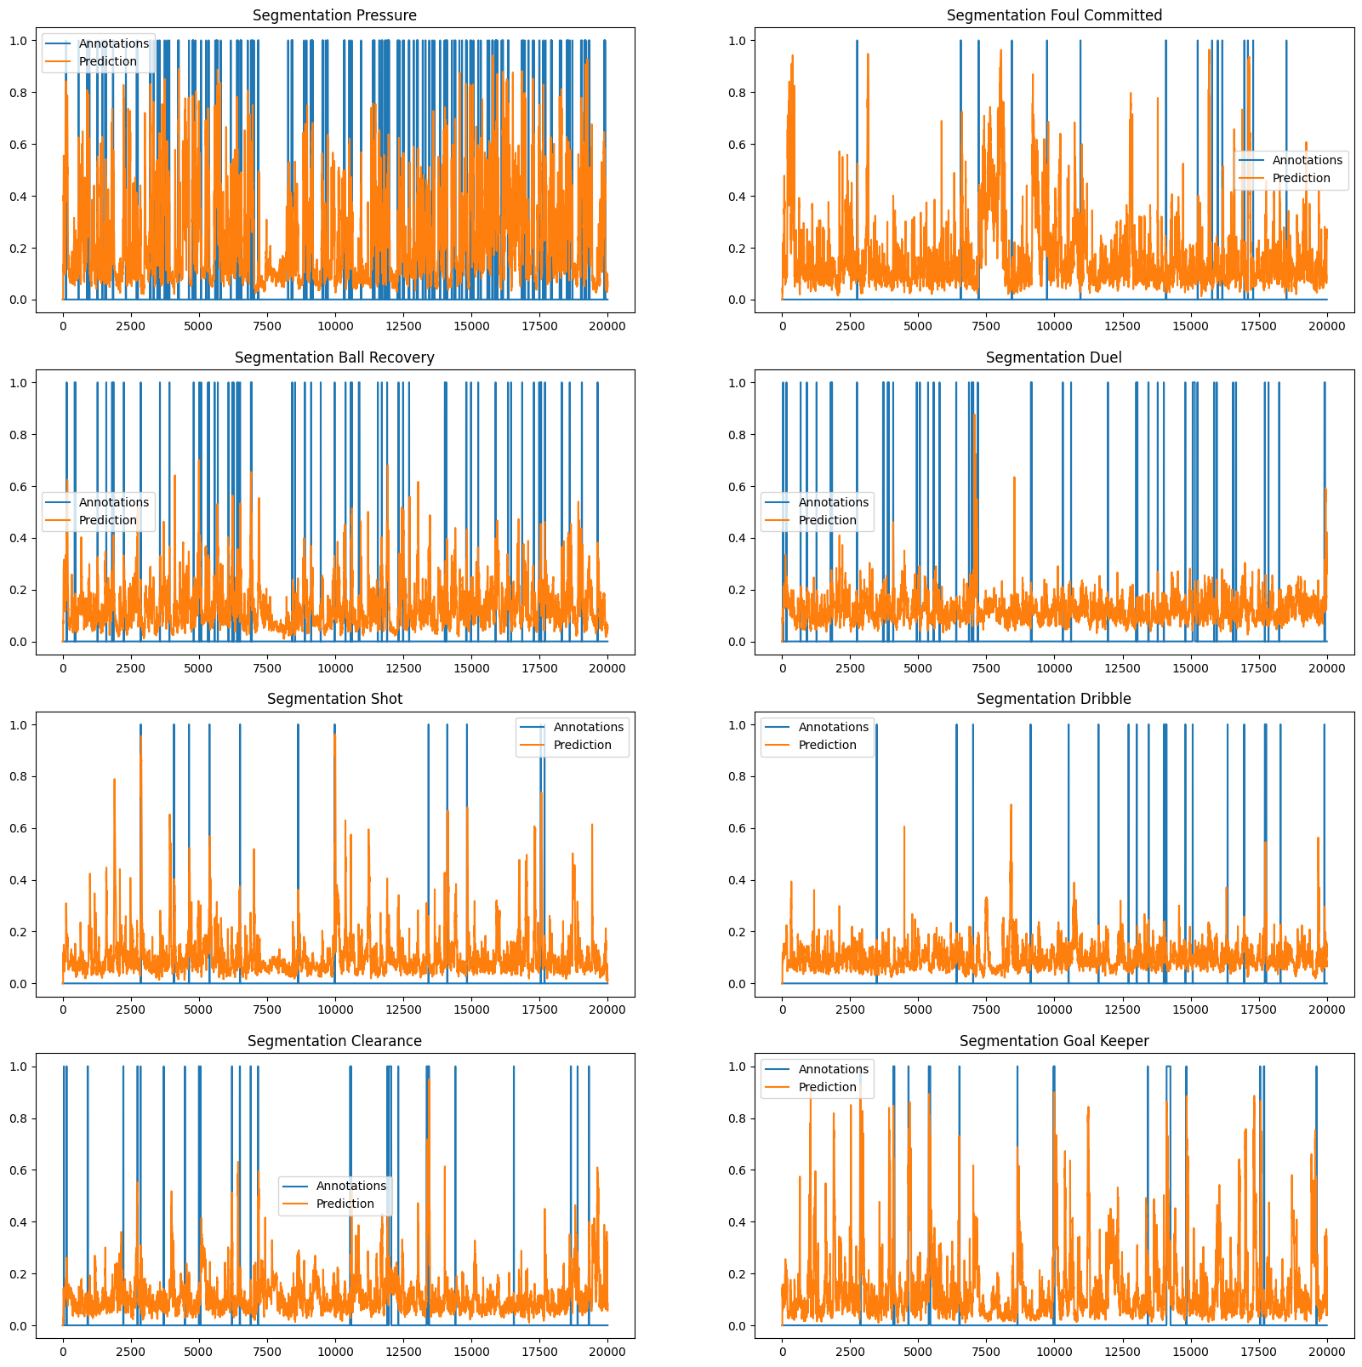
Highest - MAP
Previous

Slide 13
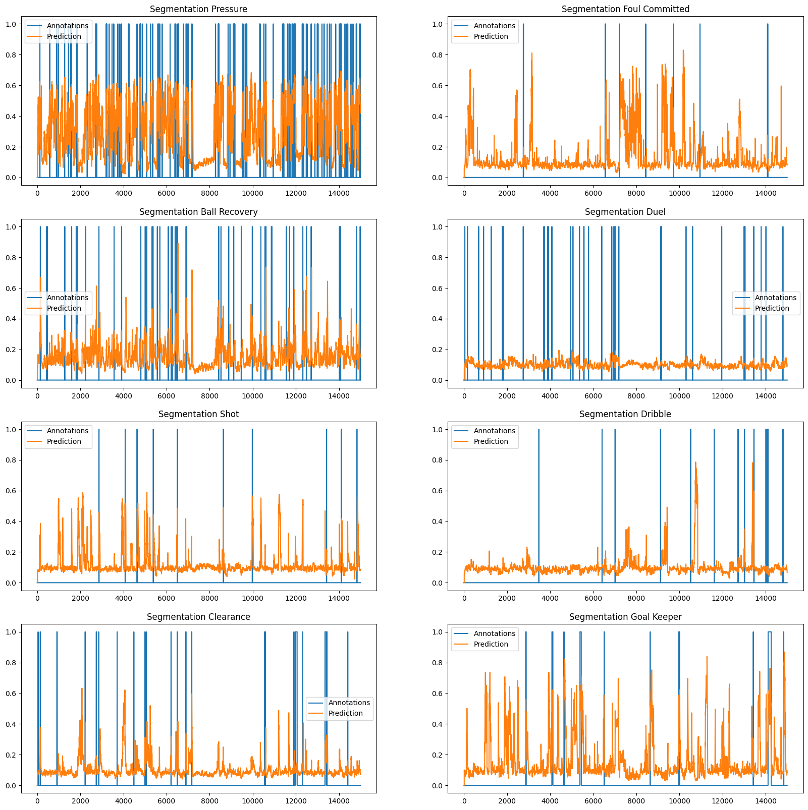
Highest - MAP
Edge Attributes

Slide 14
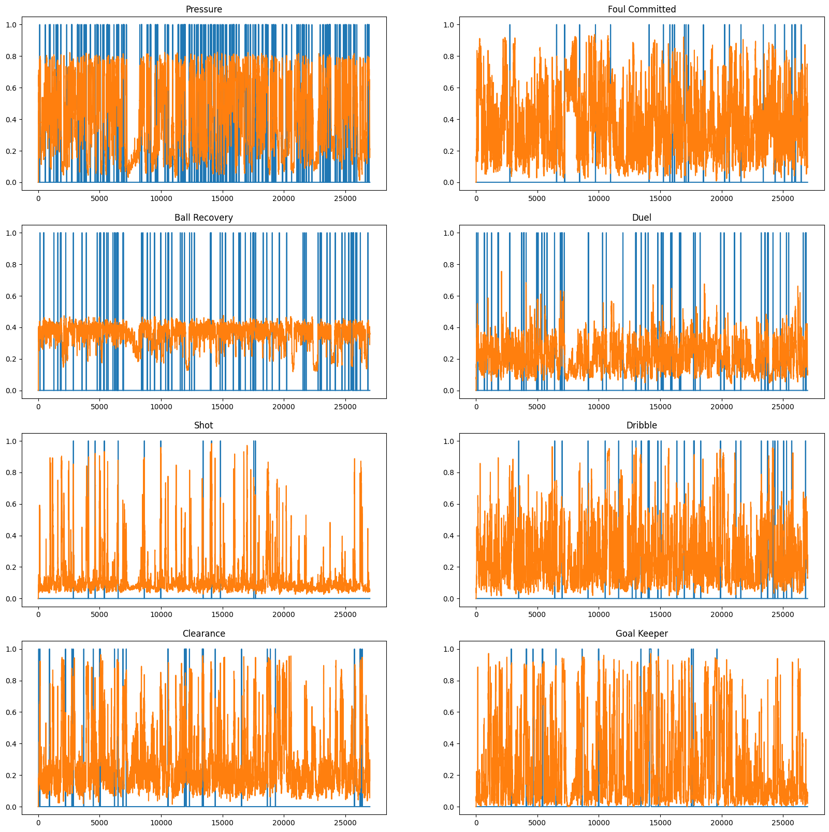
SEPERATE MODELS

Slide 15
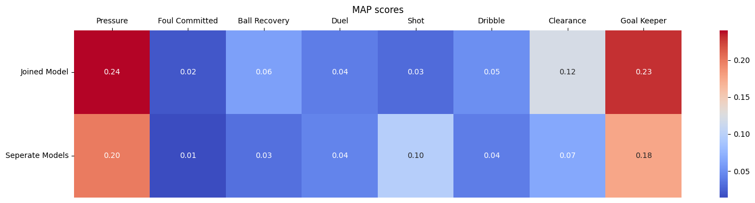
SEPERATE MODELS

Slide 16
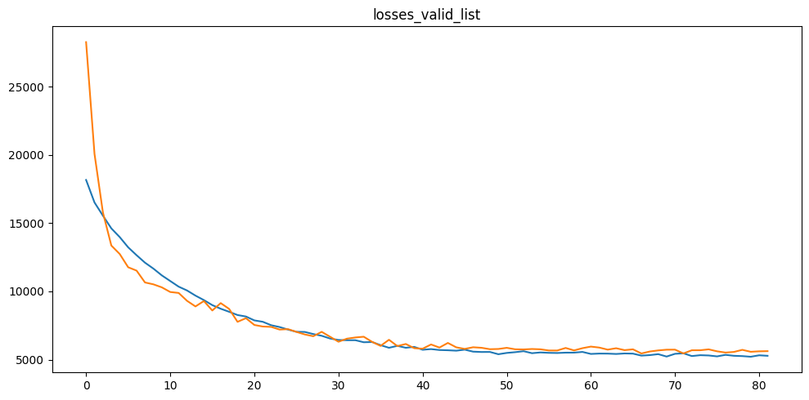
More features & edge weights + 2 annotations + augmented data

Slide 17
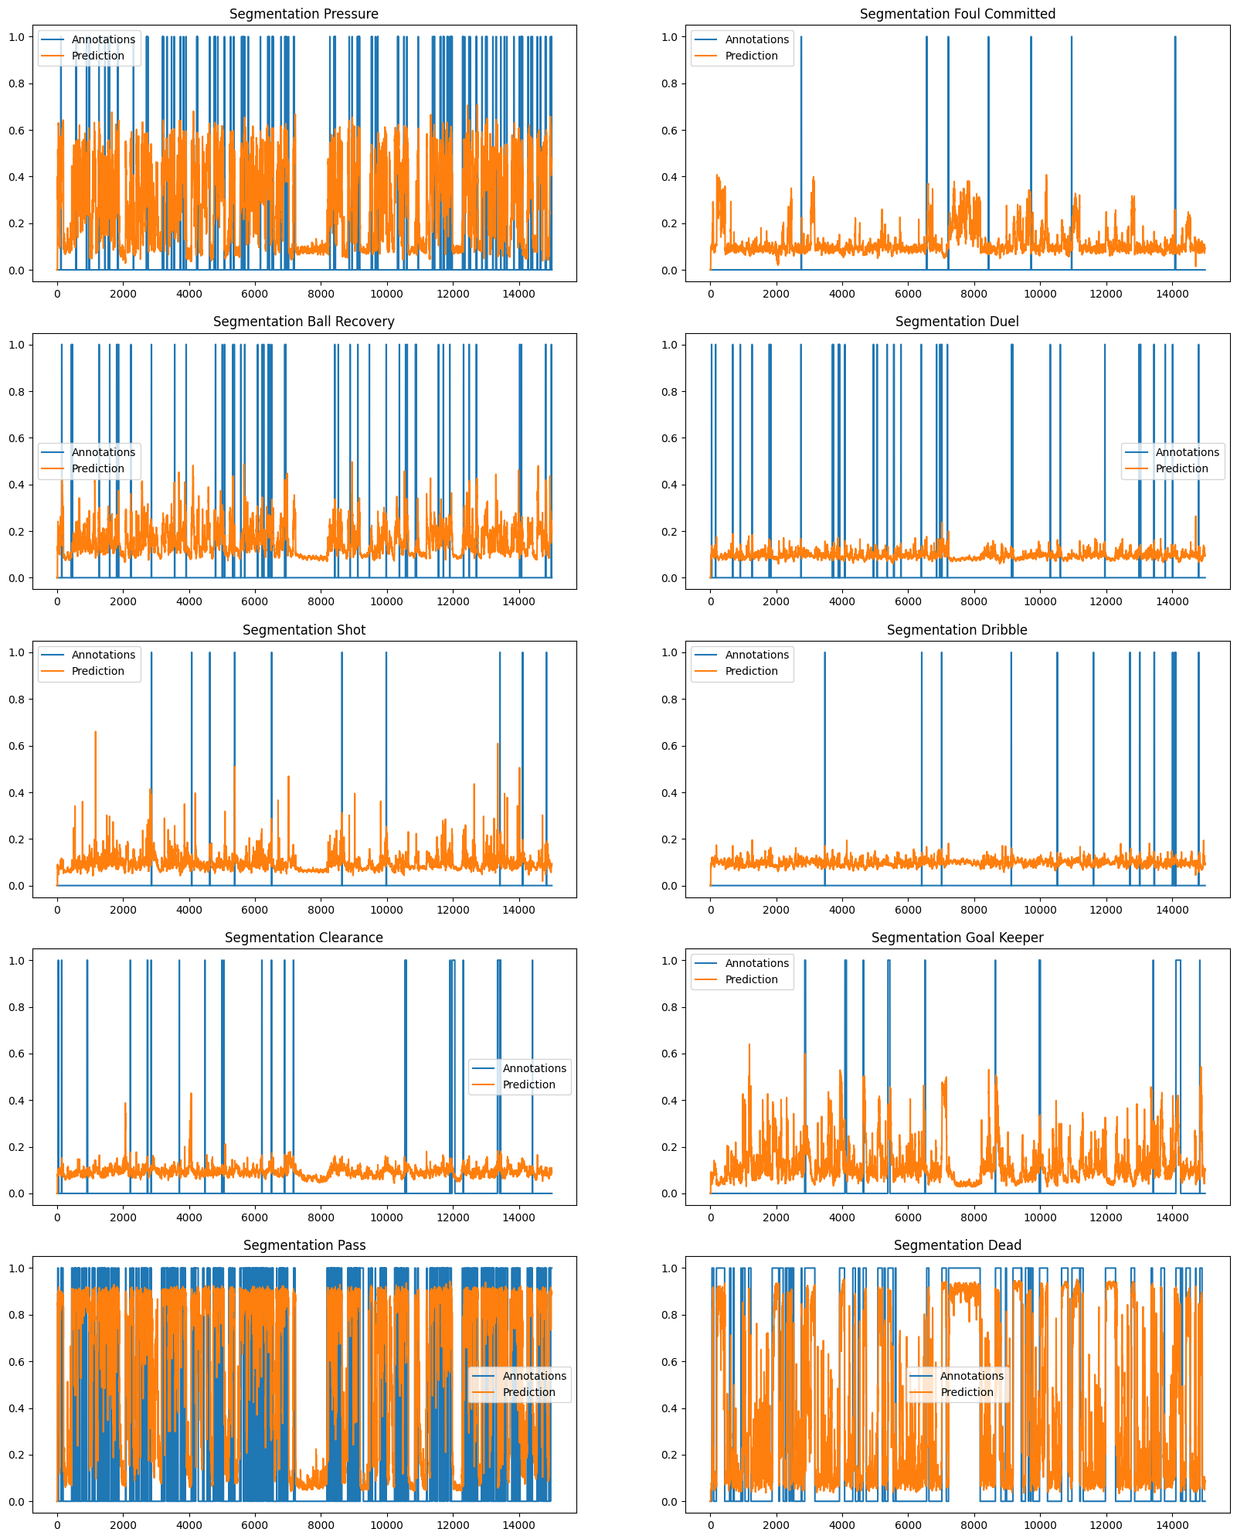
More features & edge weights + 2 annotations + augmented data

Slide 18
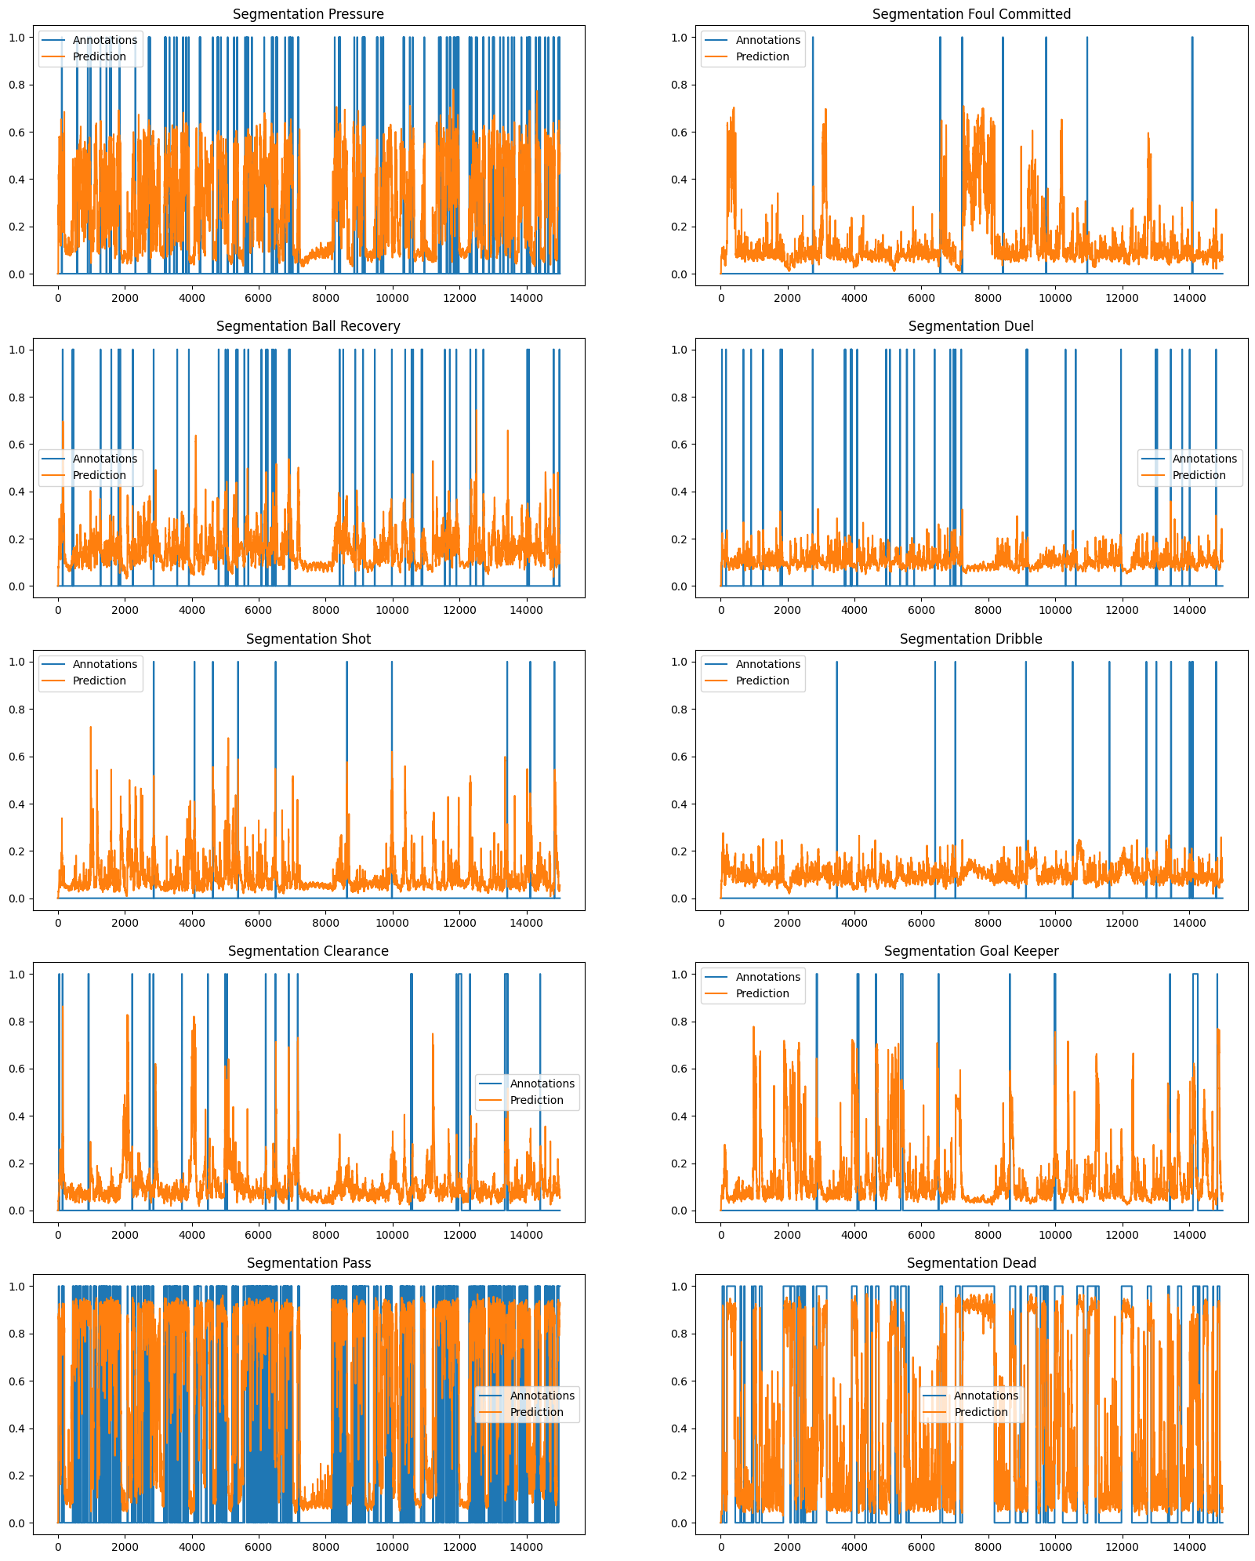
Rare actions more probable to choose hile training

Slide 20
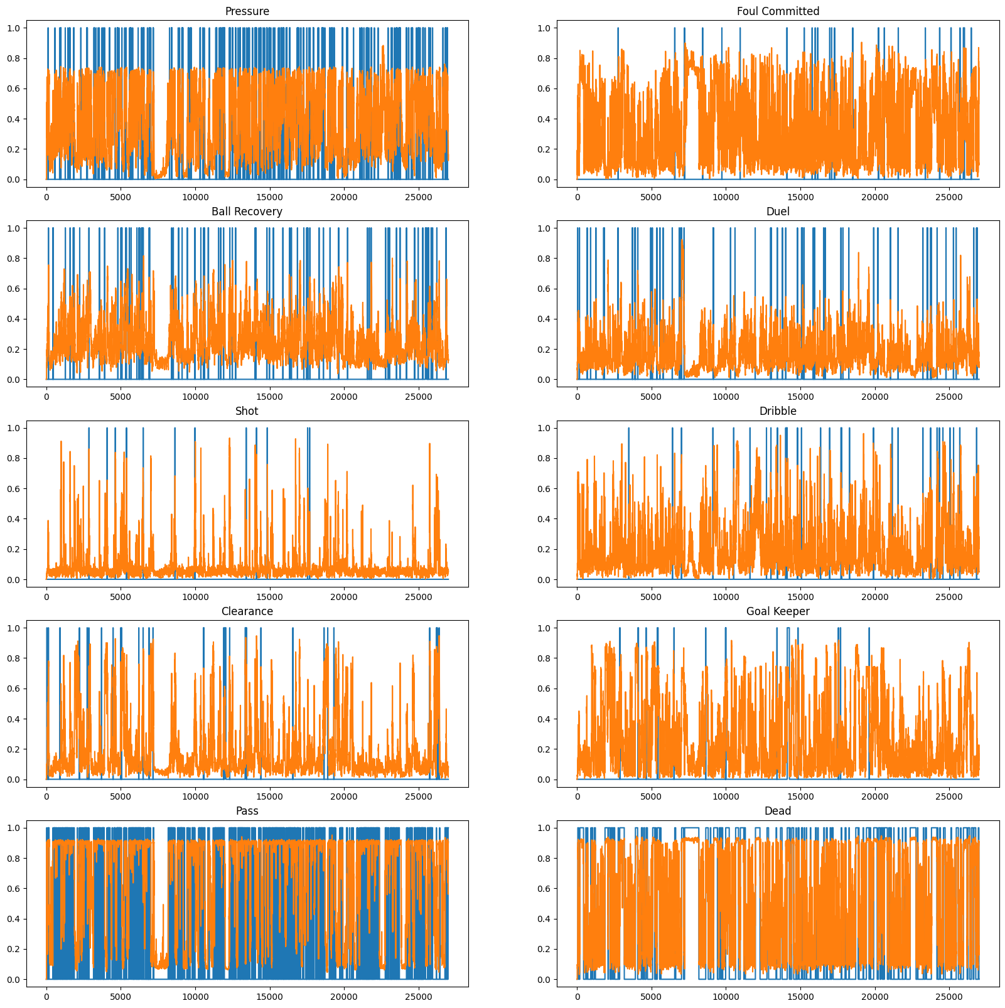
Fine Tunning

Slide 21
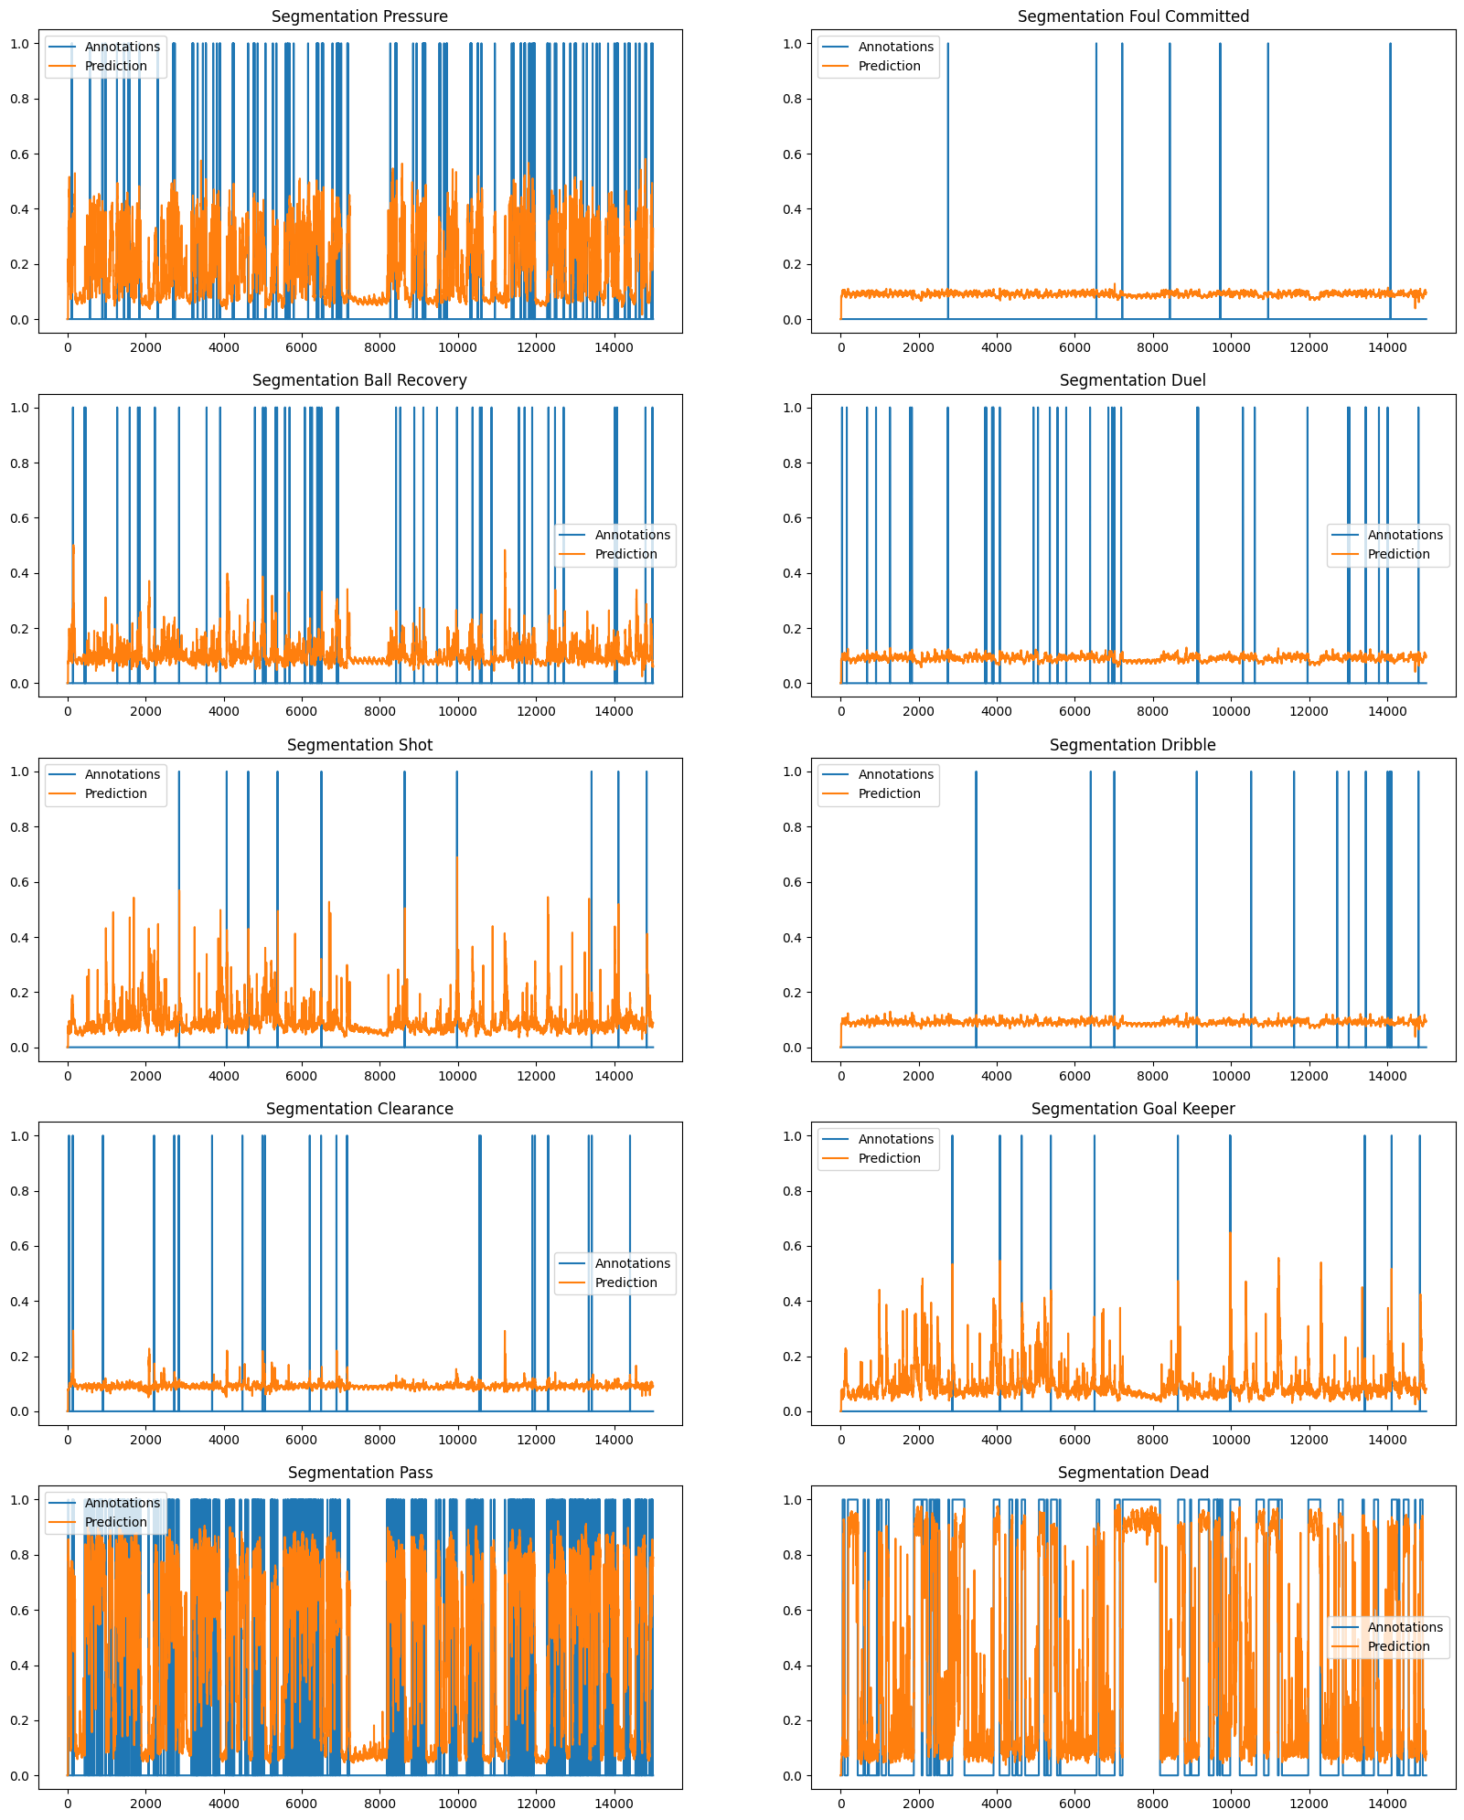
Fixed Ann Bug– Error=1

Slide 22
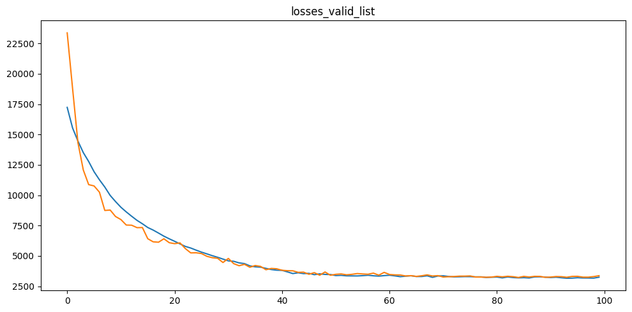

Slide 23
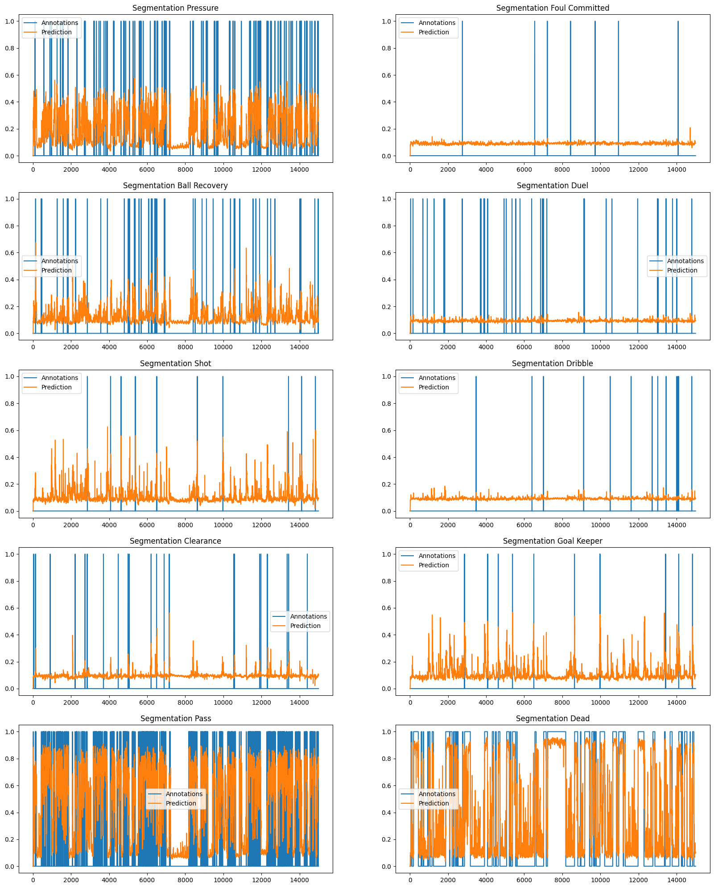
Fixed Ann Bug– Error=2

Slide 24
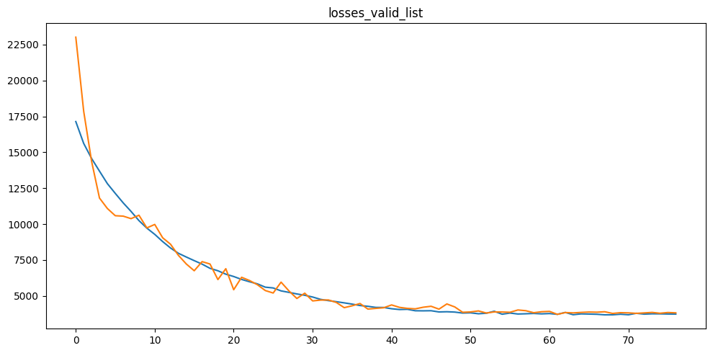

Slide 25
Spotting Module - Idea

Slide 26
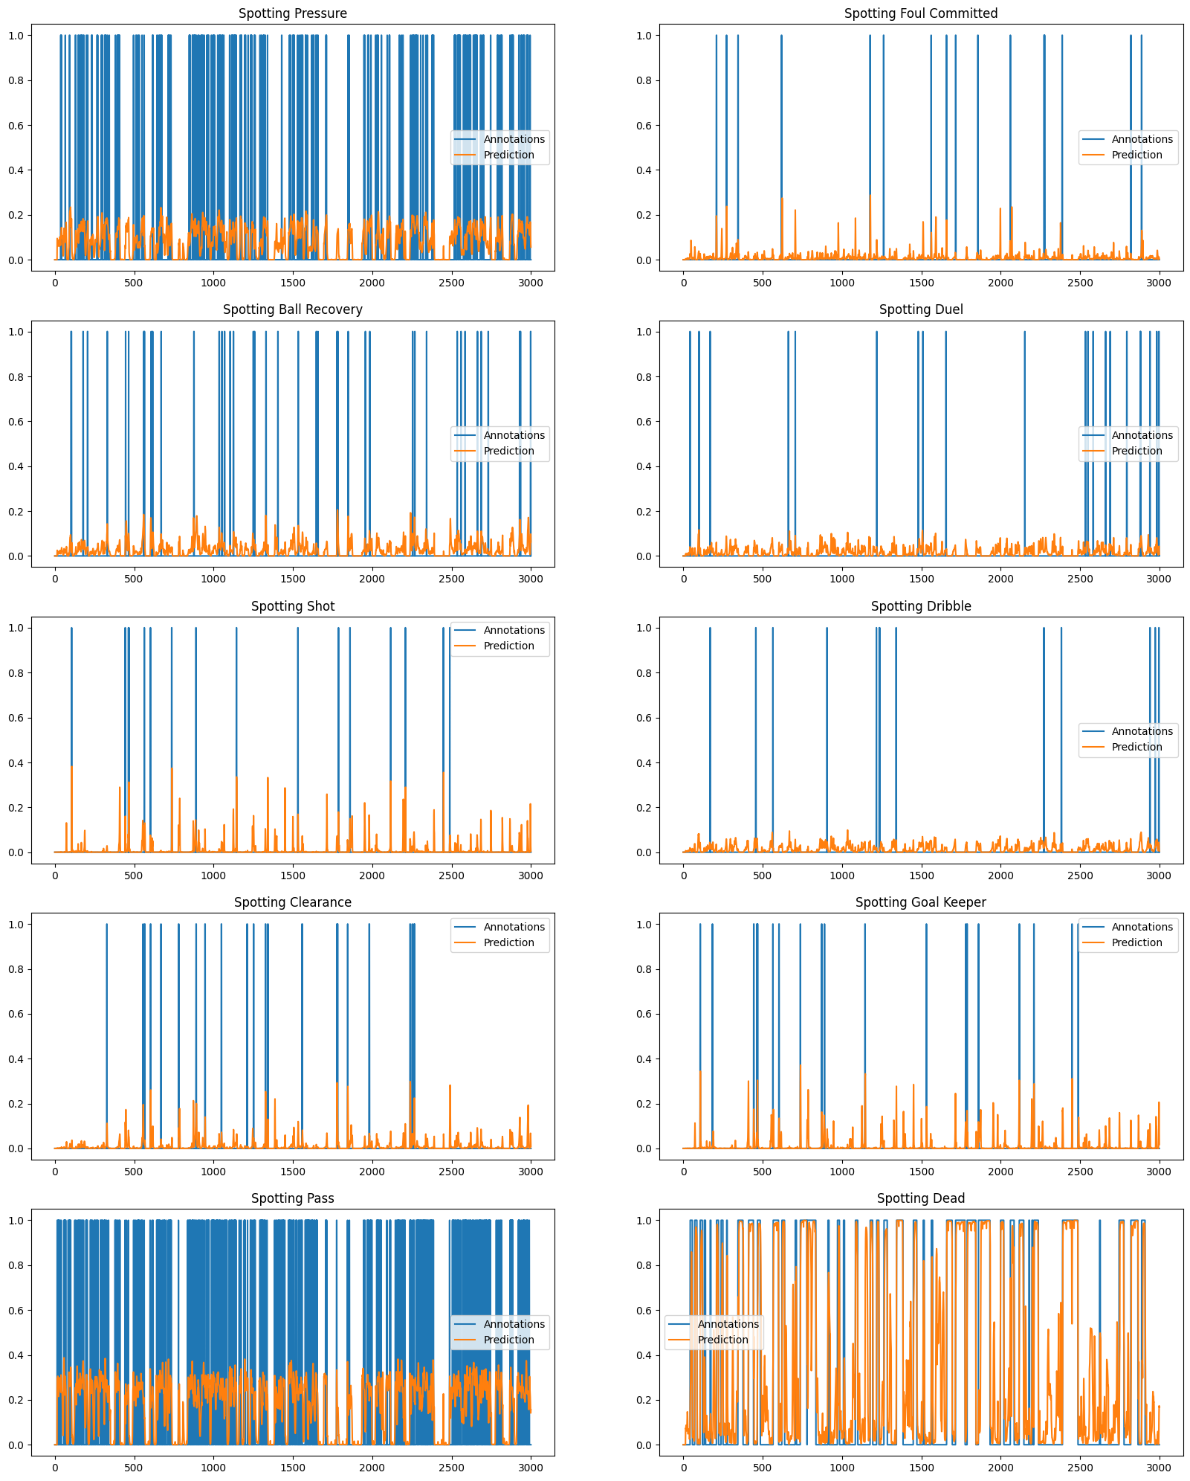
FIRST SPOTTING RESULTS

Slide 27
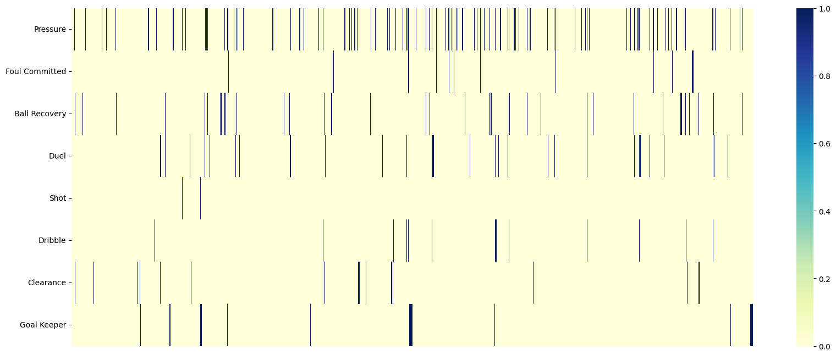
Event distribution in the game

Slide 28
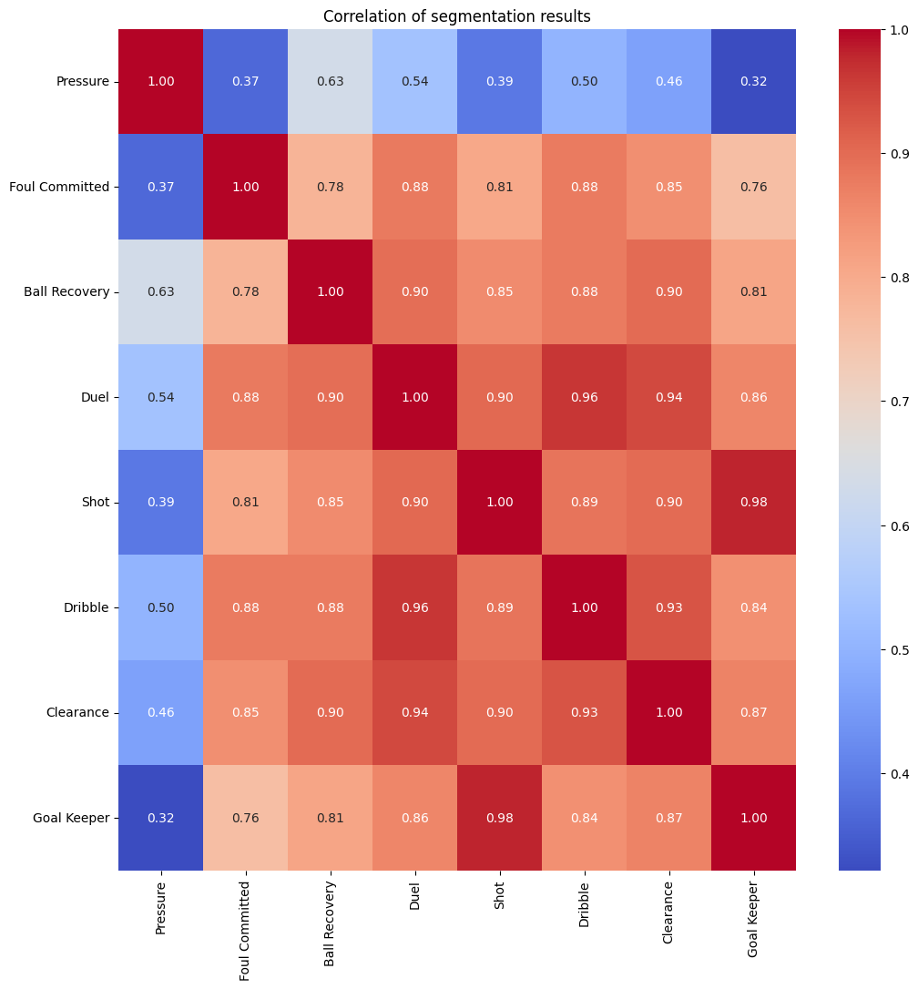
Correlation of the Segmentation Results

Slide 29
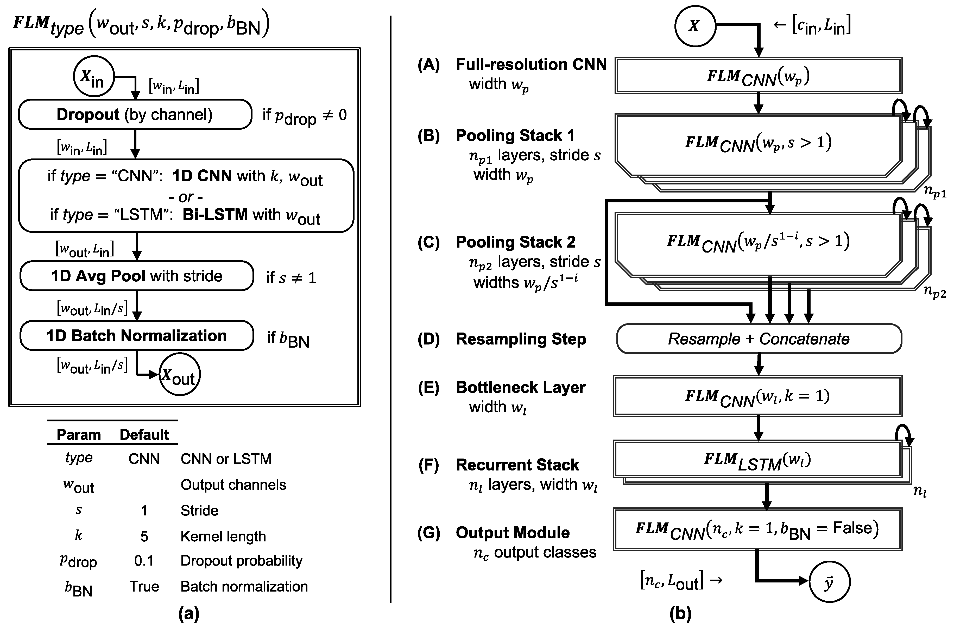
FilterNet

Slide 30
Proposed Pipeline
FilterNet
(LSTM-bidir)
SEGMENTATION MODULE
(Black Box)
CONCATENATE
AVG POOL
LINEAR
SIGMOID
CONVOLUTION
ALONGSIDE
EVENTS
FilterNet
(LSTM-bidir)
CONVOLUTION
WHOLE SEQUENCE

Slide 31
PLAN - IDEAS
SEGMENTATION MODULE:
Create new features and attributes: acceleration, differences between velo acc and dir in edge attributes, accumulated avg v, a, dir.
Standardize somehow direction etc?
Visualise the predictions, analyse the spikes without annotations.
Remove threshold for edges (additionally).
Play with K params individually to capture the impact / remove receptive field.
Generate augmented data, by mirroring actions.
Include dead and pass for annotations might be helpful further for spotting.
Analyse somehow embeddings or attributes (need ideas).
Select more often annotations which perform badly.
For single models different way of choosing an anchor so negative samples were chosen.
Transfer learning: learn model for all then fine tune to specific events
*** CLEAN THE CODE ***
SPOTTING MODULE
Build pipeline and start experimenting with the number of FN cells.
Potential issue: double overfitting.
Decide about LossFunction, parametrise it as the data is unbalanced

Slide 32
Proposed Pipeline
SEGMENTATION MODULE
(Black Box)
FilterNet
(LSTM-bidir)
CONCATENATE
AVG POOL
LINEAR
SIGMOID
CONVOLUTION
WHOLE SEQUENCE

Slide 33
Proposed Pipeline
SEGMENTATION MODULE
(Black Box)
FilterNet(ann8)
CONCATENATE
AVG POOL
LINEAR
SIGMOID
FilterNet(ann7)
FilterNet(ann2)
FilterNet(ann1)

Slide 34
Loss Animation

Slide 35
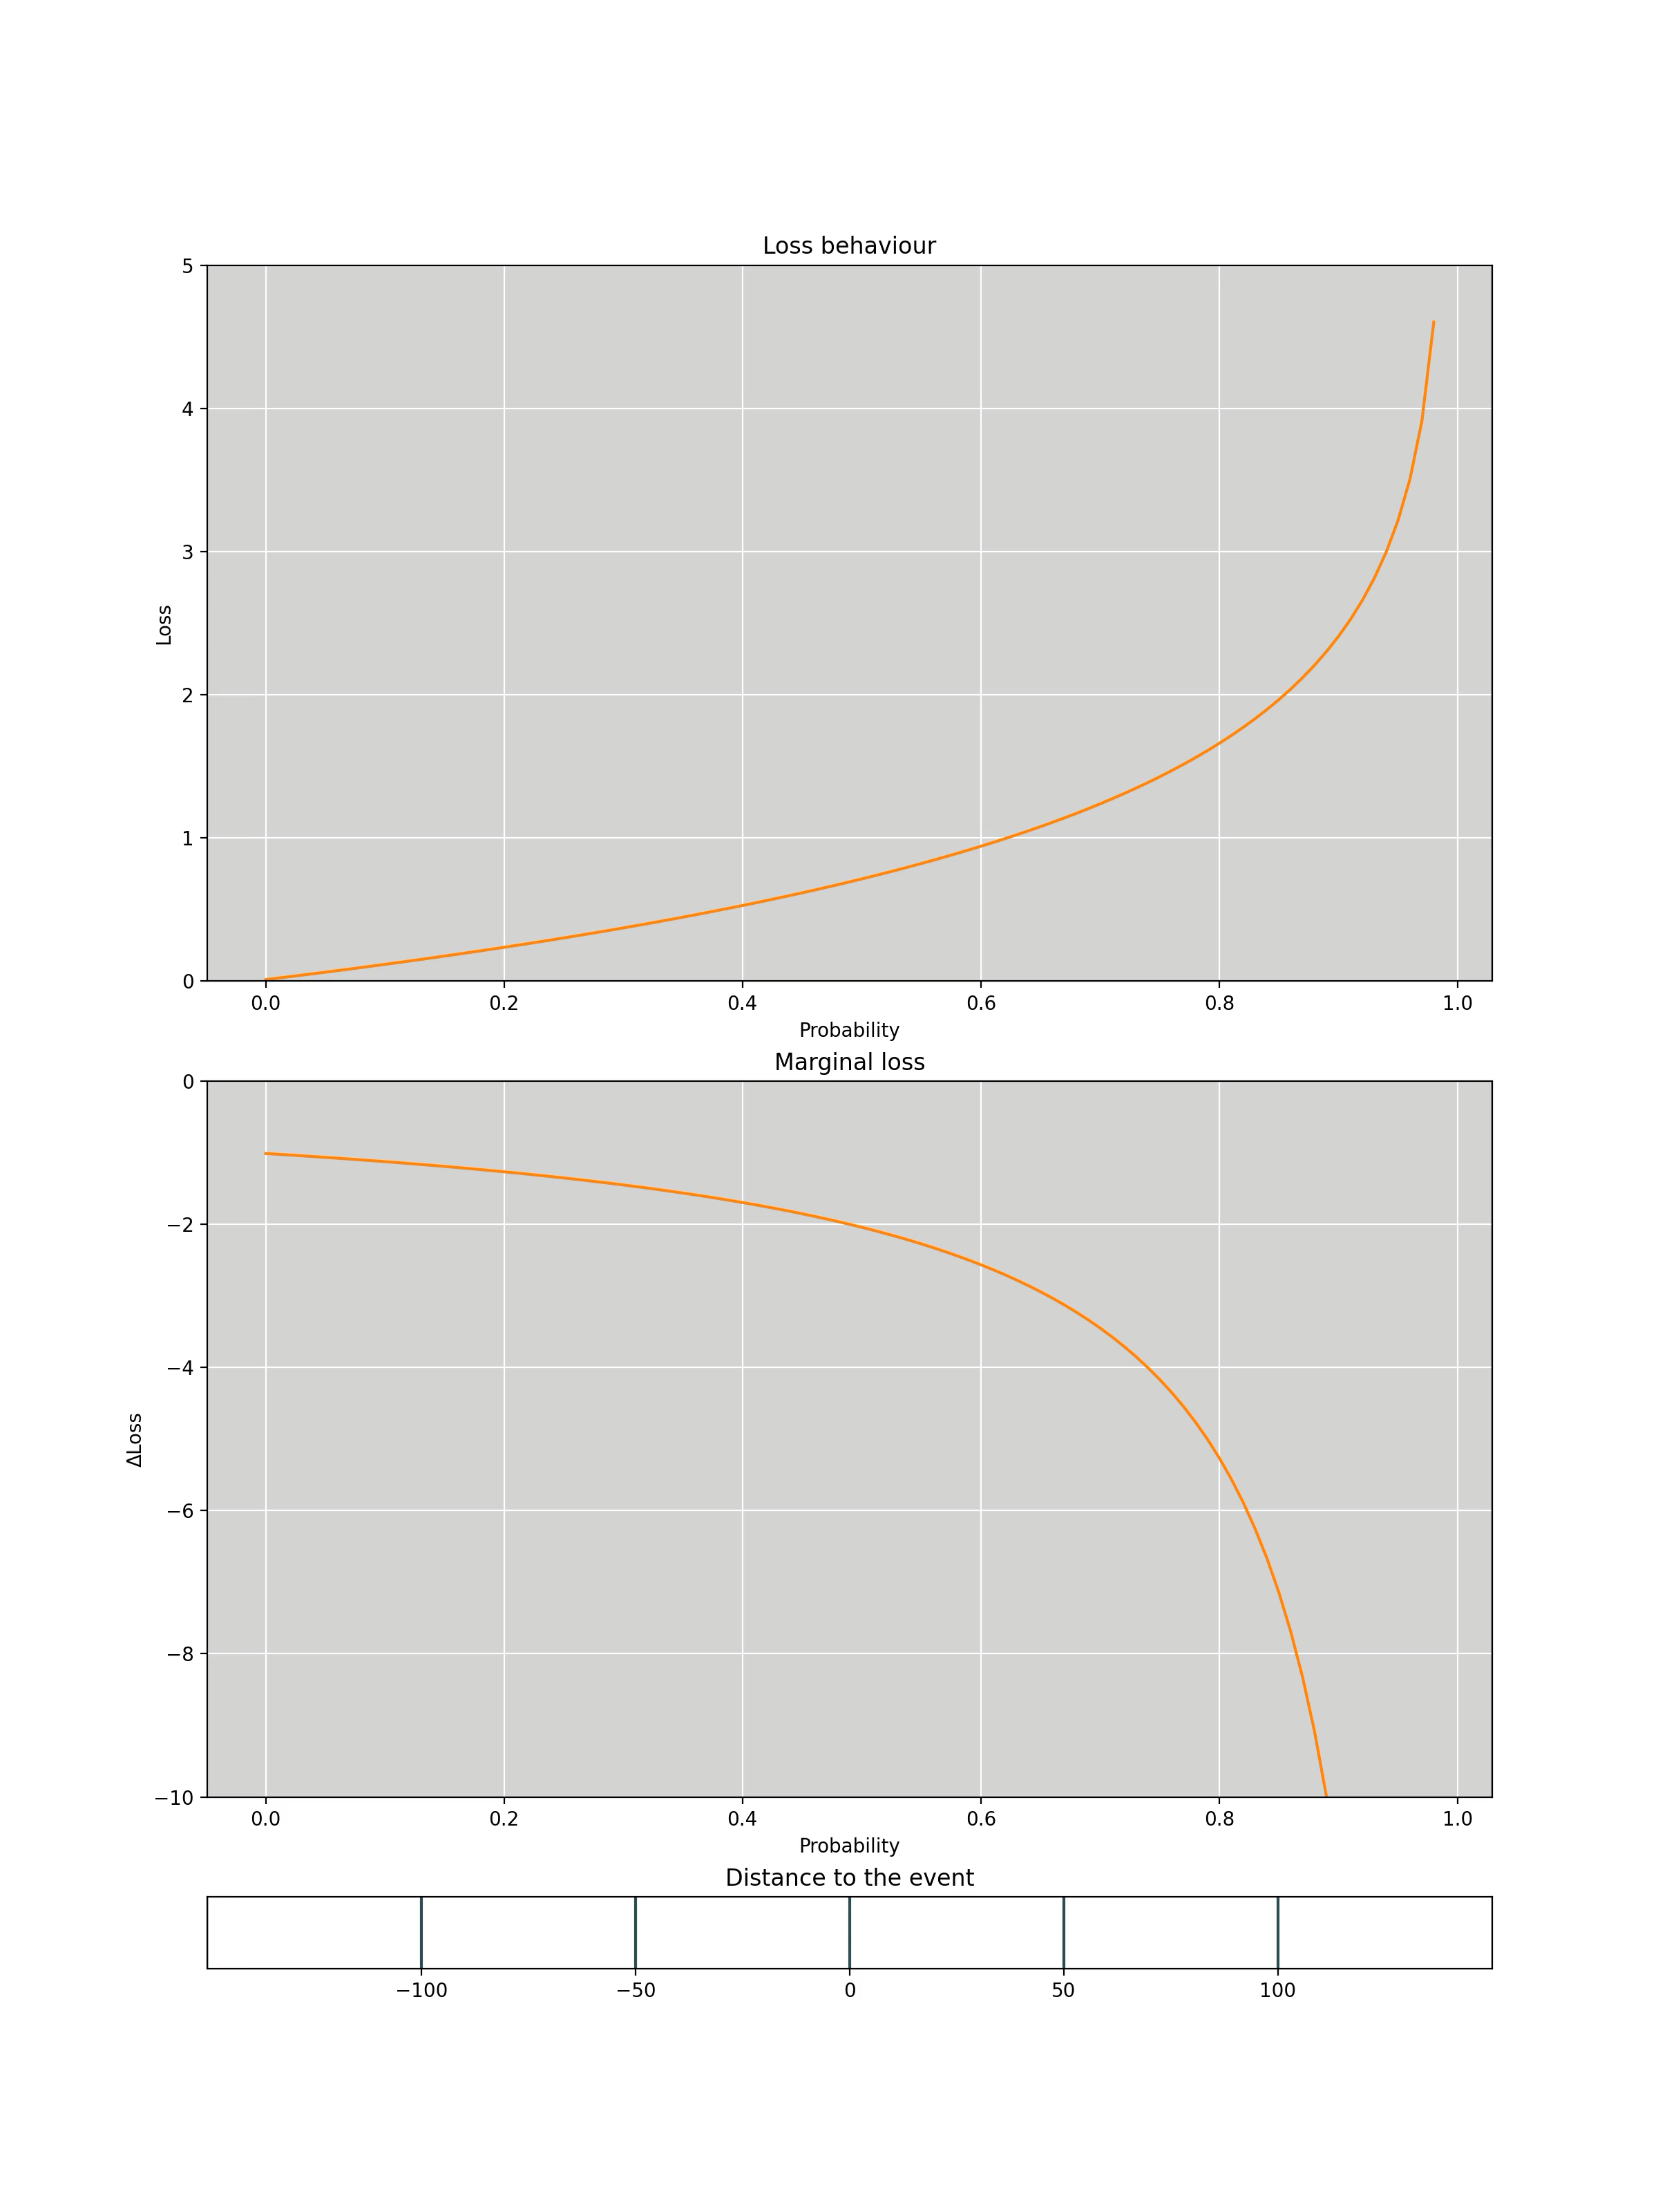
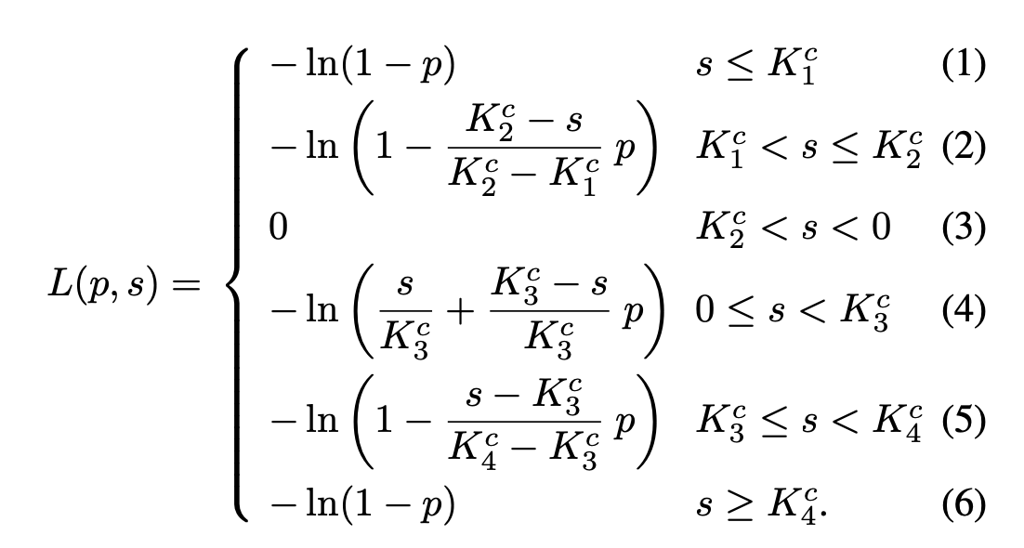
Context Aware Loss Function

Slide 36
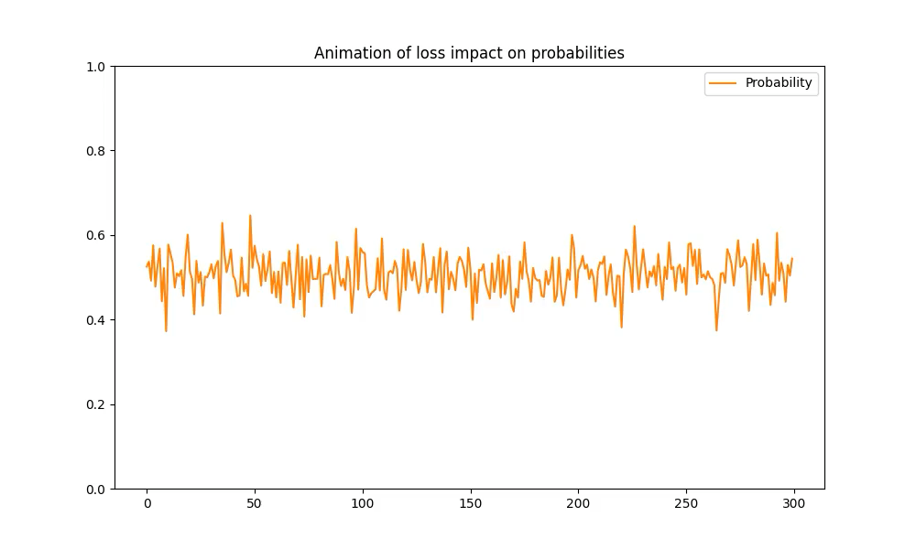
Loss Impact on Logits

Slide 37
Evaluation Metric

Slide 38
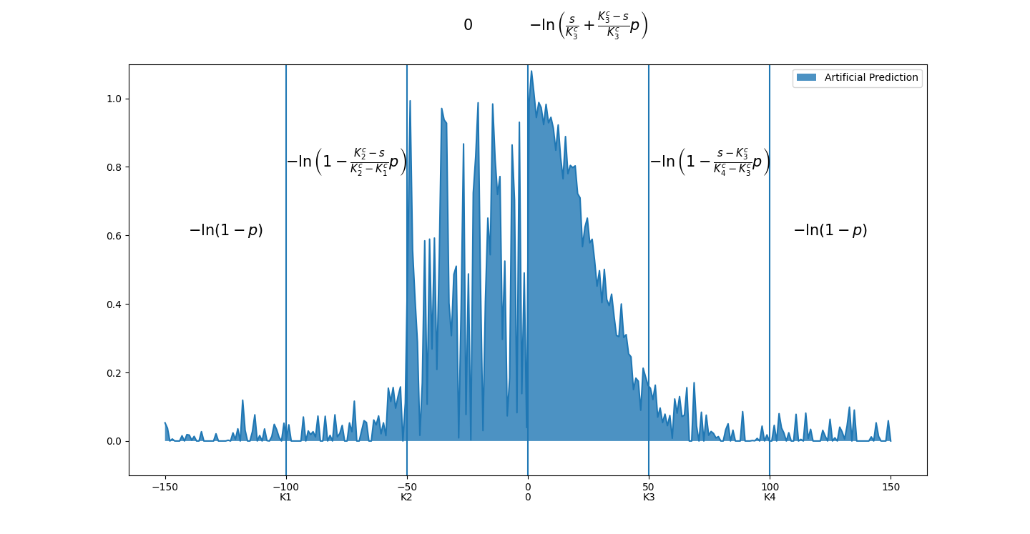
Artificial Loss Impact on Logits Distribution

Slide 39
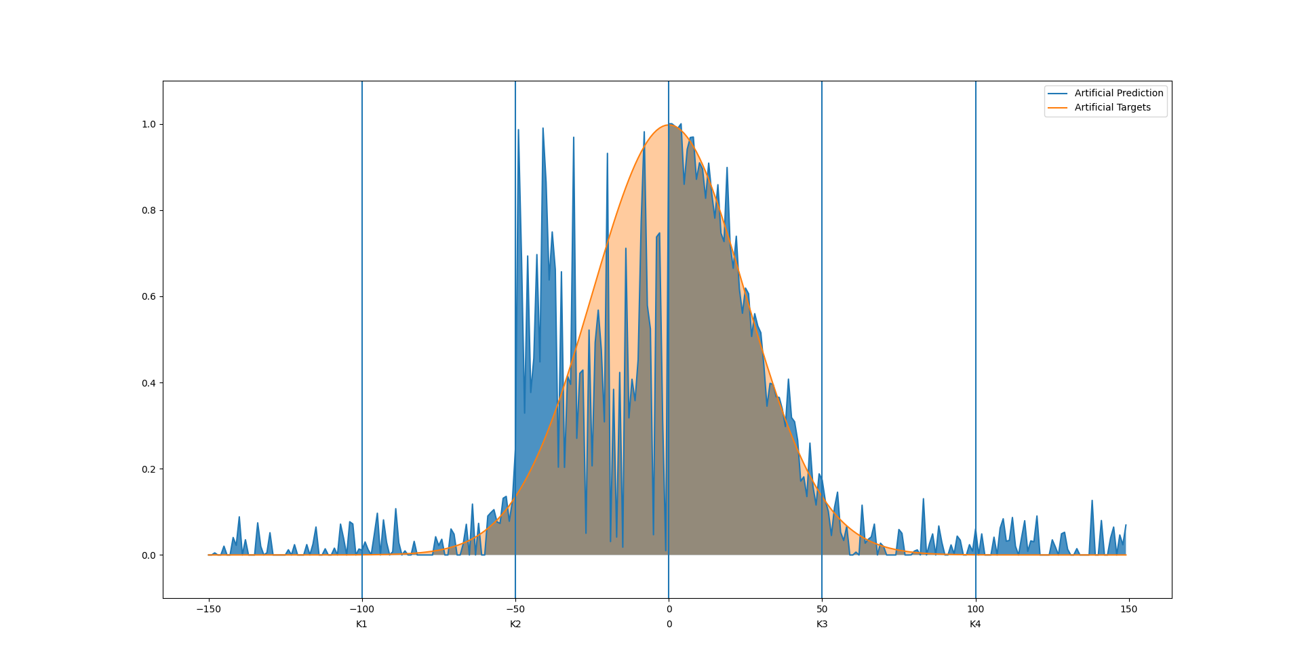
Artificial Targets

Slide 40
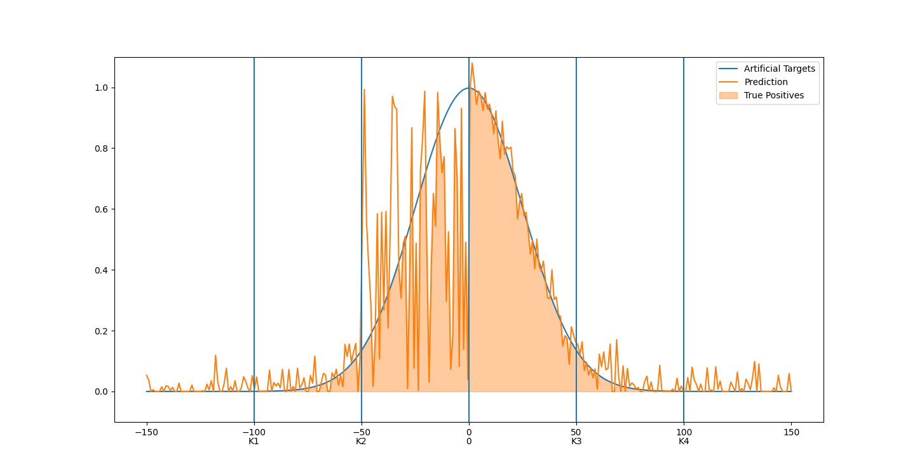
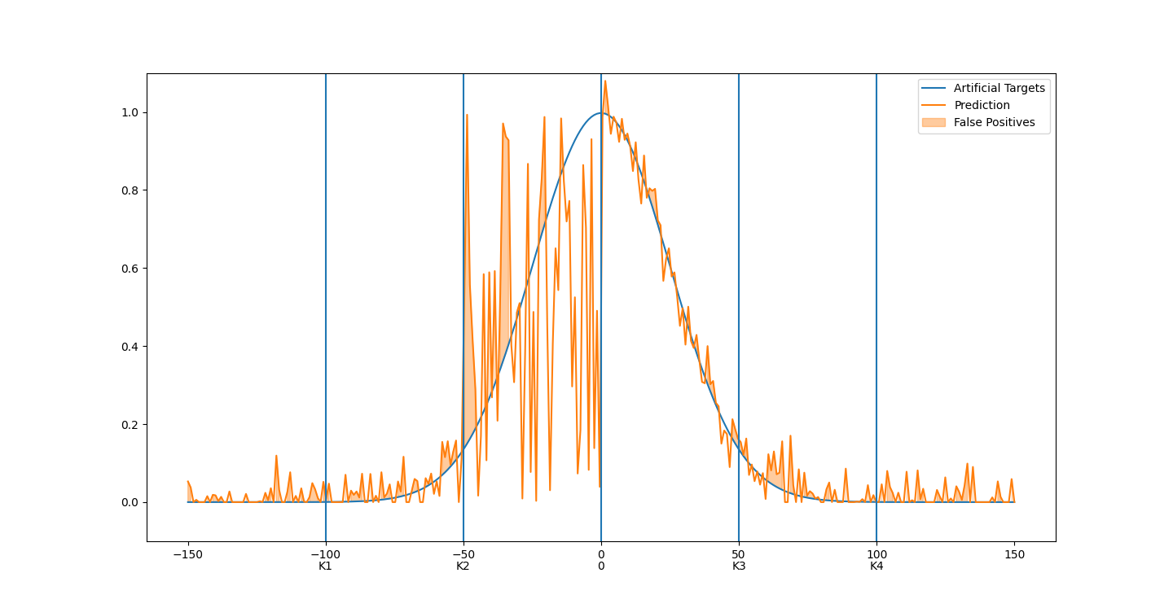
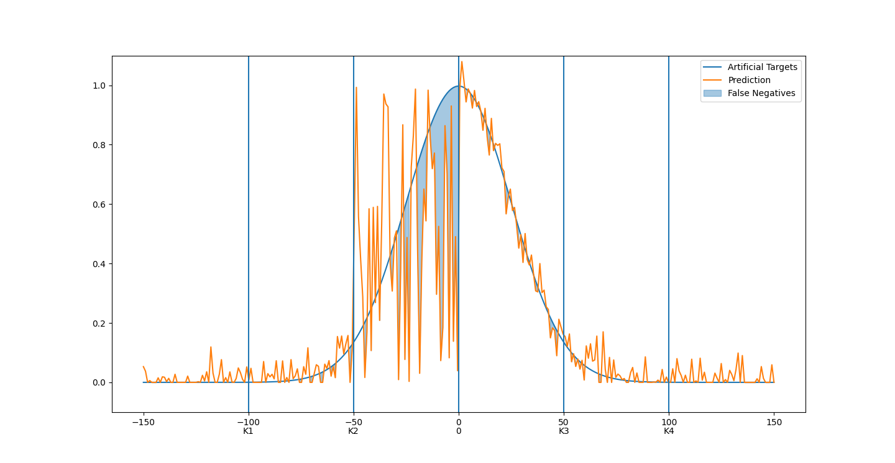

Slide 41
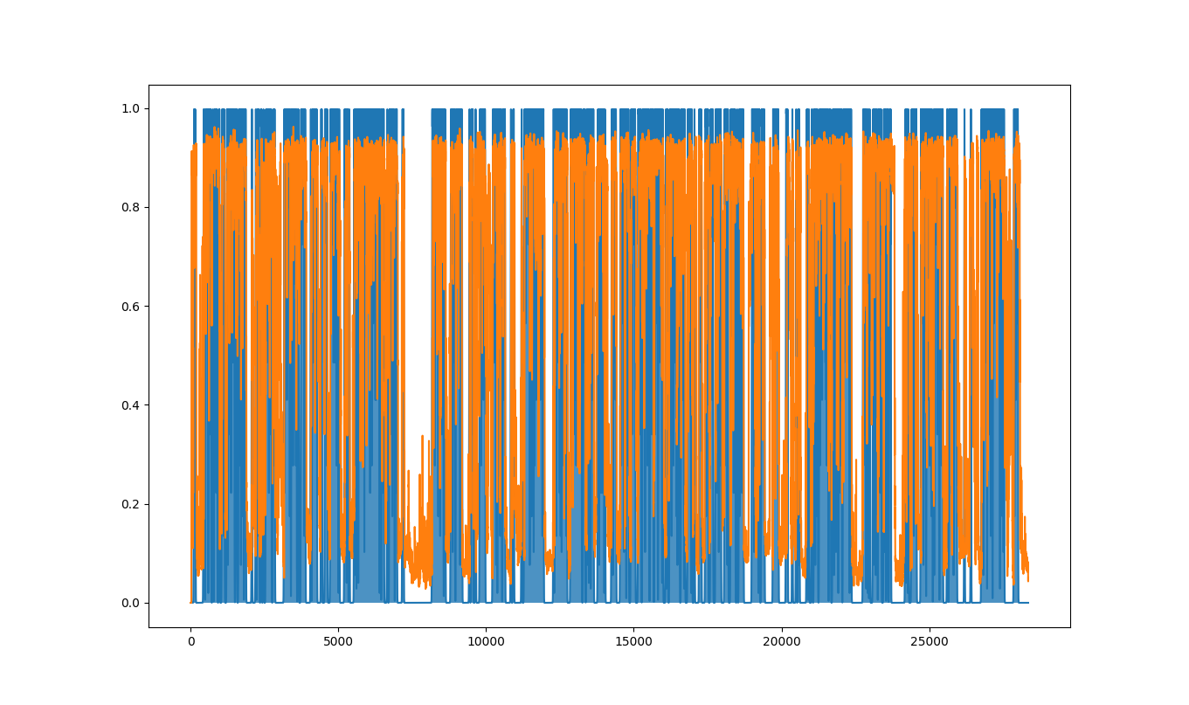

Slide 42
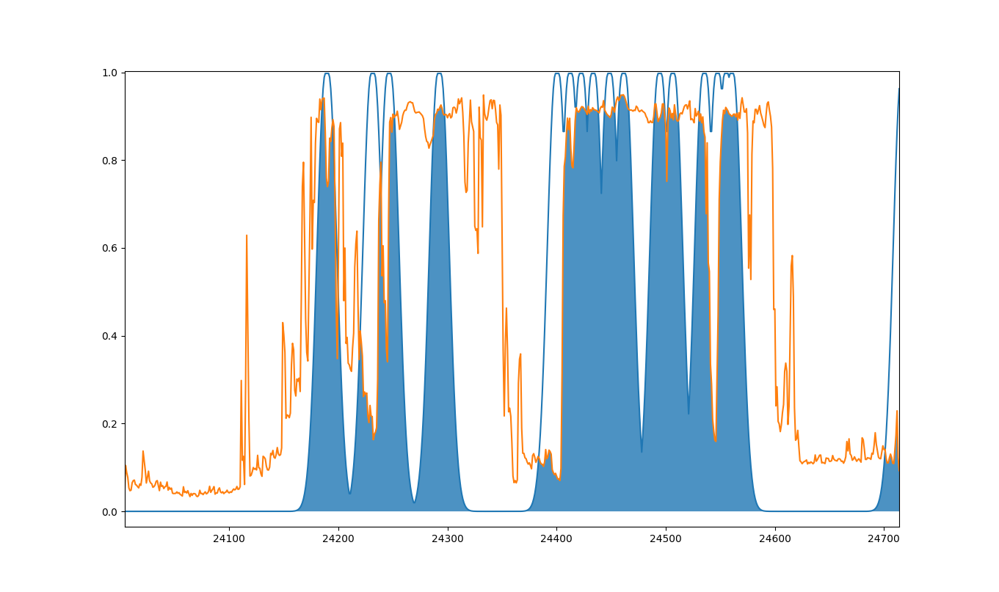

Slide 43
Retrained Segmentation Models

Slide 44
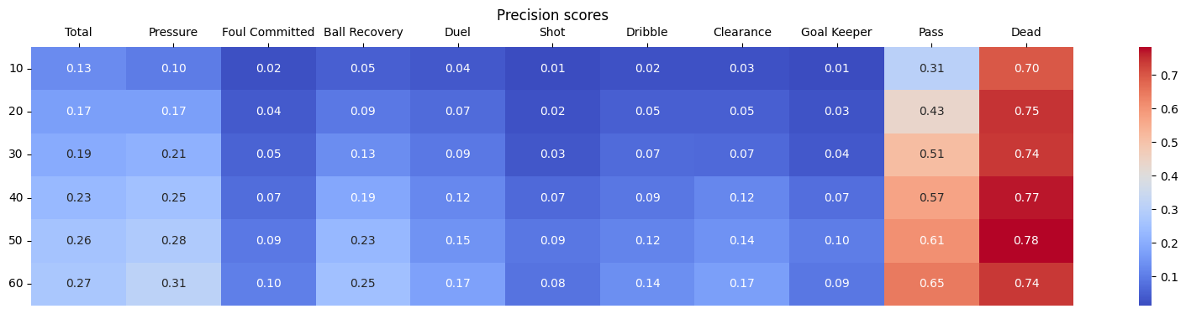
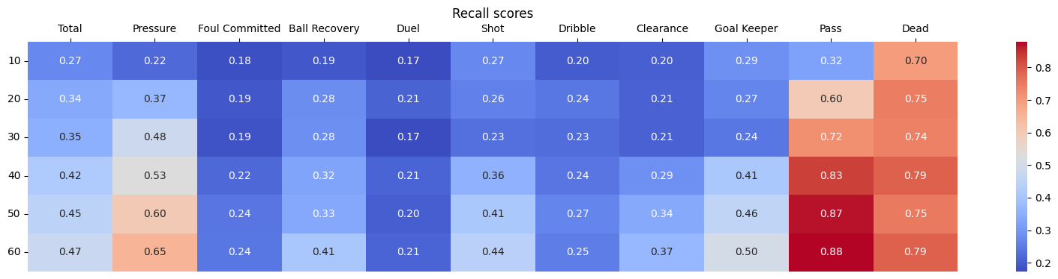
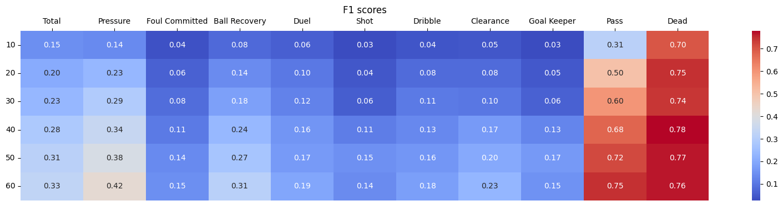
Base Model

Slide 45
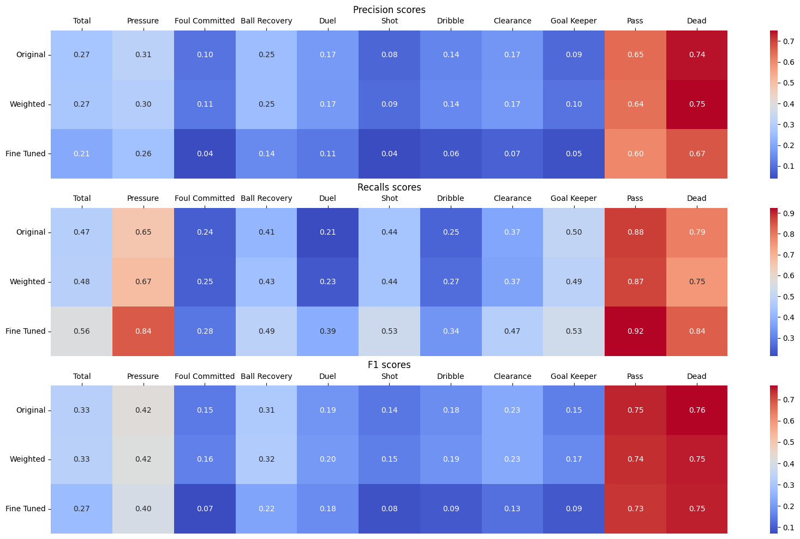
Other Models

Slide 46
IDEAS
Segmentation Module
Change settings in models related to edges
Test Other Graph Models: GAT & GIN
Use Artificial Targets instead of CALF
Add more context: use commentary transcripts and use for instance BERT model

